Slide 1

Drive Easy Rental
Presentation

Slide 2

Key Functionality
Login user and admin
Register user
Book rental car
Show rental cars
Update and delete cars

Slide 3
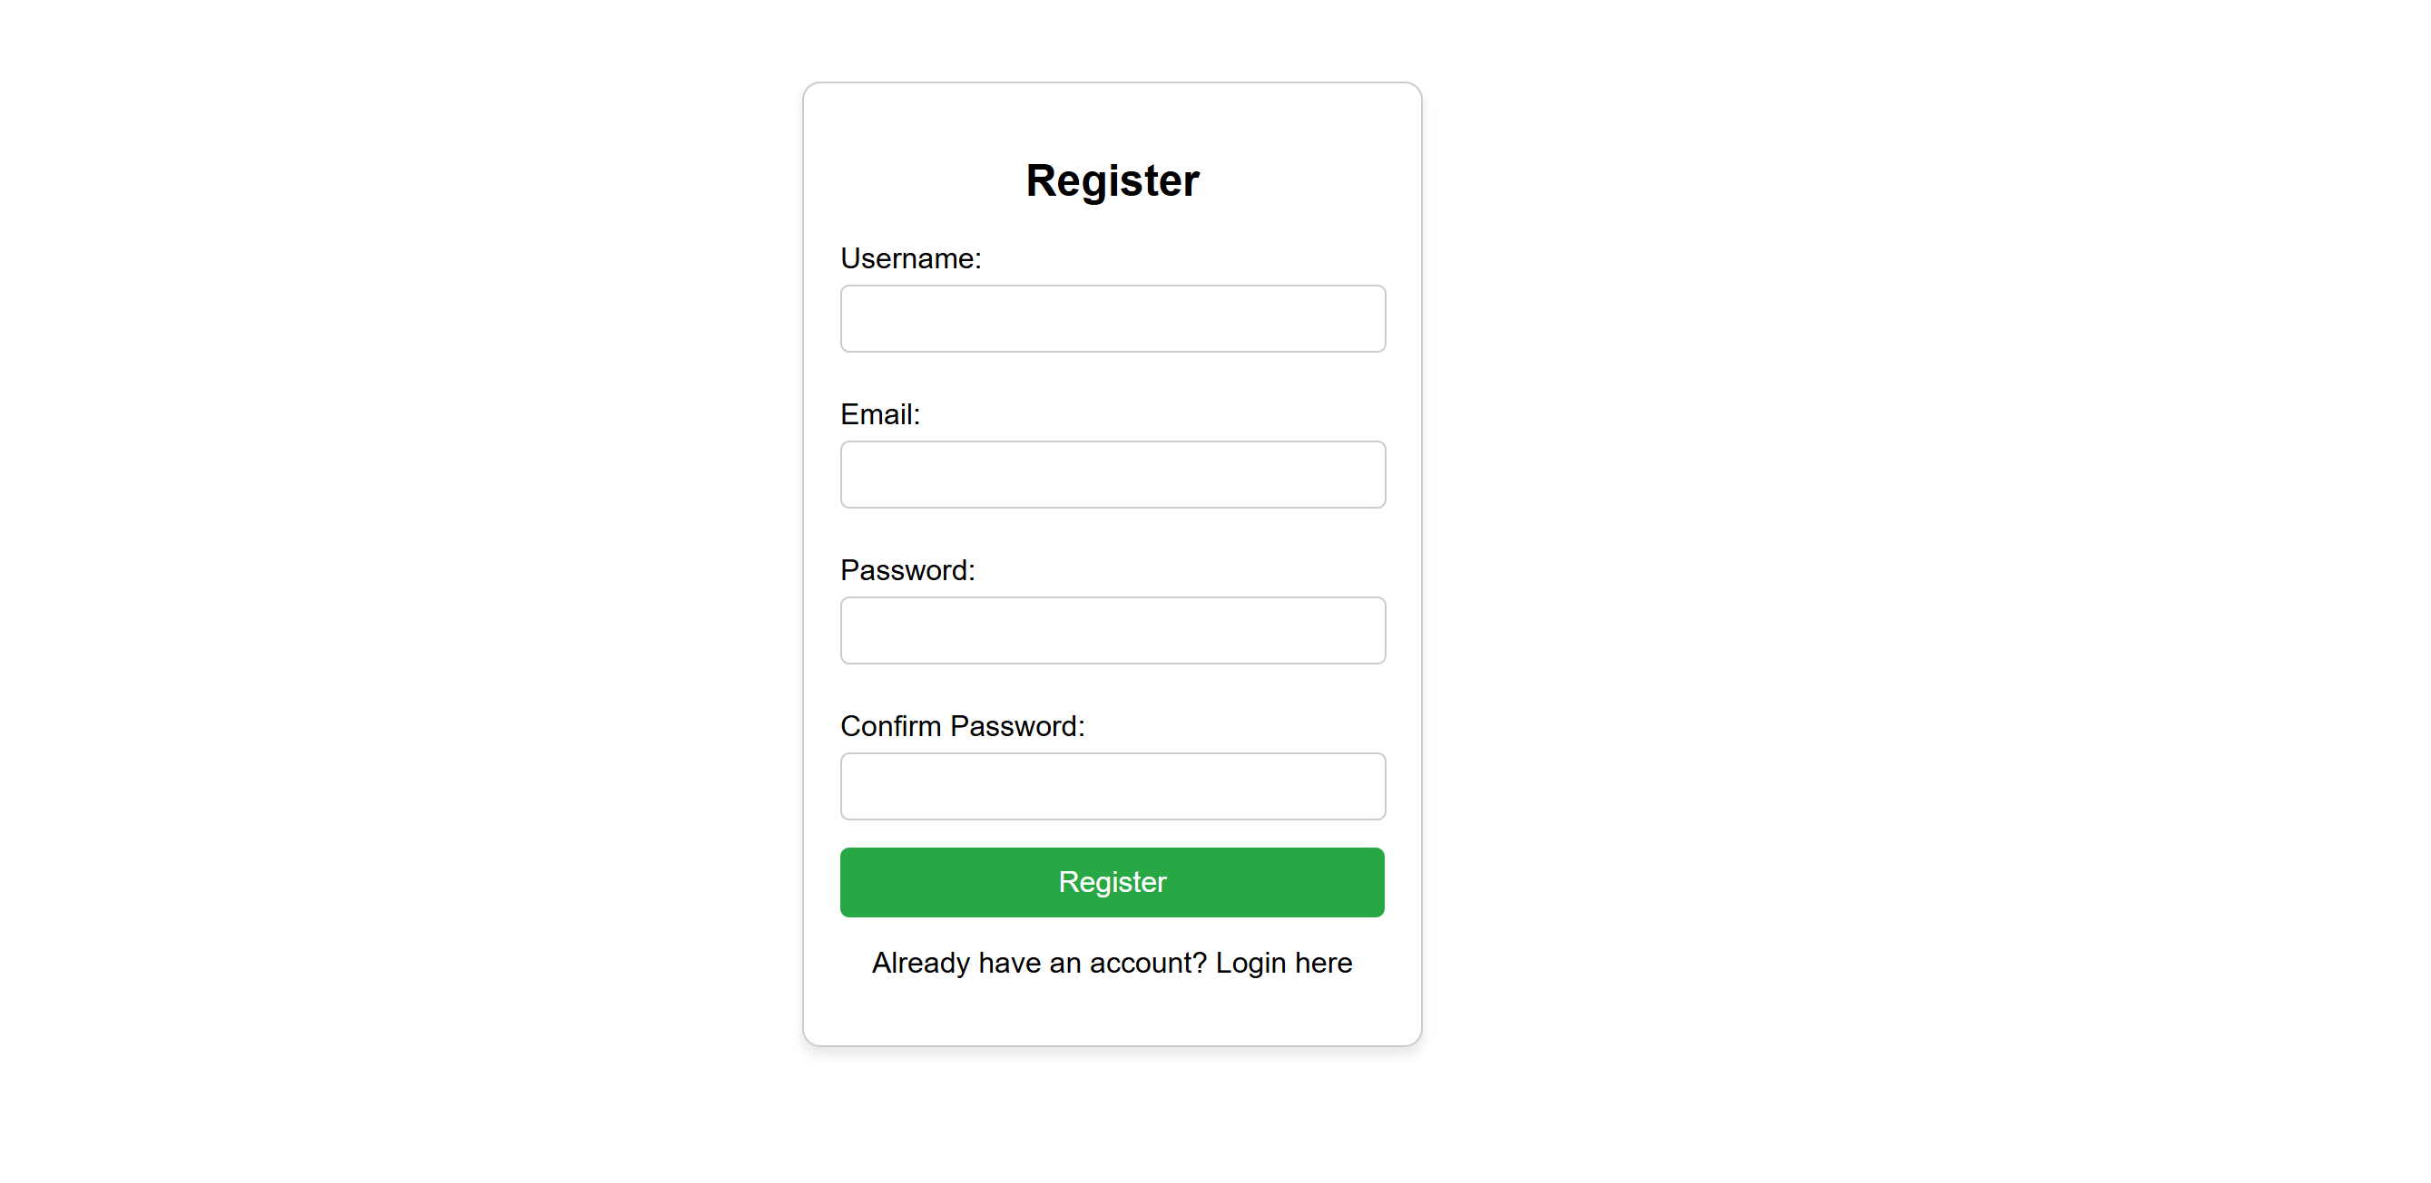
Register
The user requires to register first before accessing the drive easy rental website.
The user requires to add username, email, password to register in the system.
All this information will get stored in the database.

Slide 4
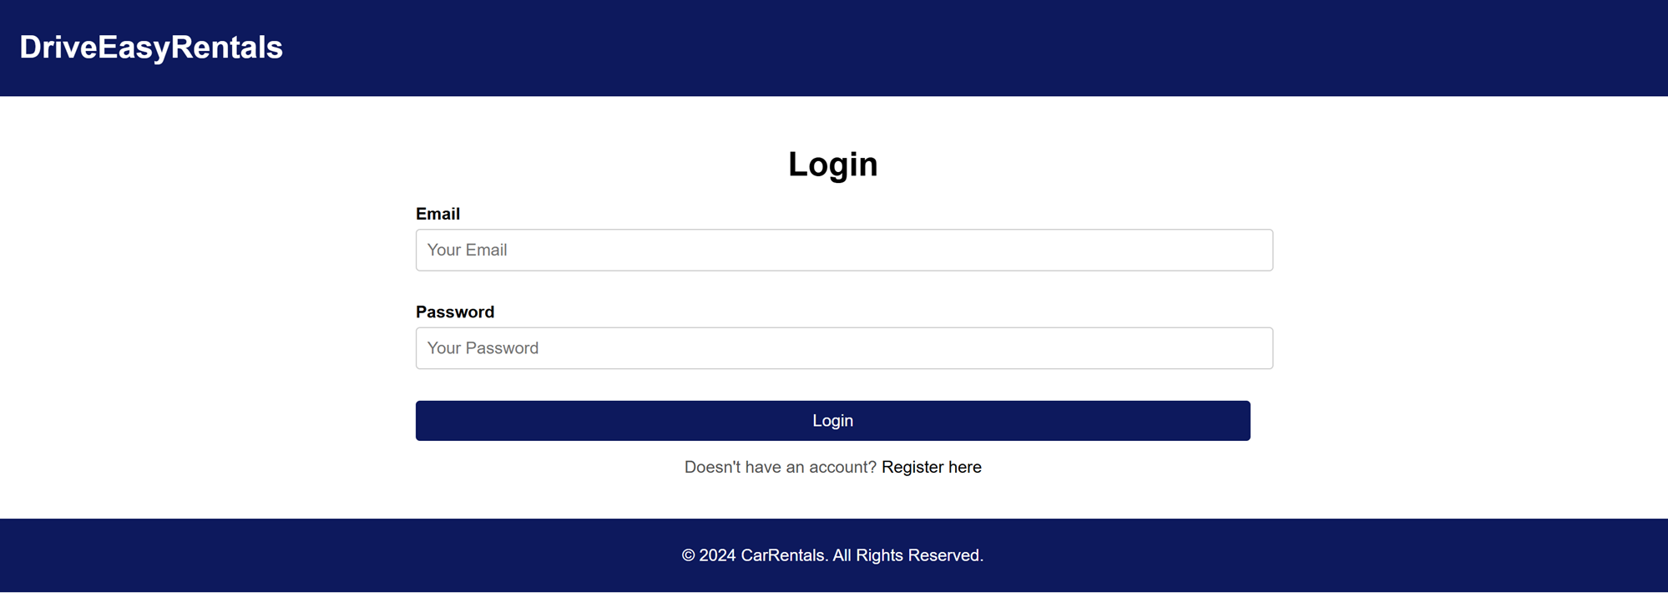
Login
For login, user or admin can enter their information and click on login button.
If the role is user then system will redirect to the user index page.
If the role is admin then system will redirect to the admin index page.

Slide 5
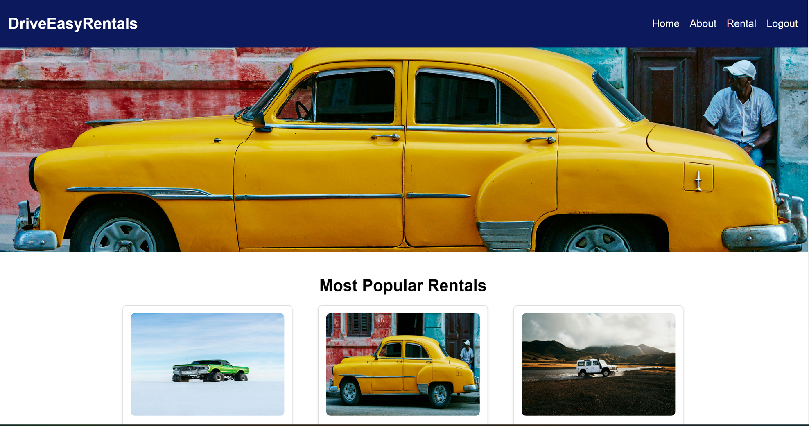
User index page
This page shows all main information required to show the user at the start.
It shows slider at top and most popular rental cars at the bottom.
It has information fetched dynamically from the database.

Slide 6
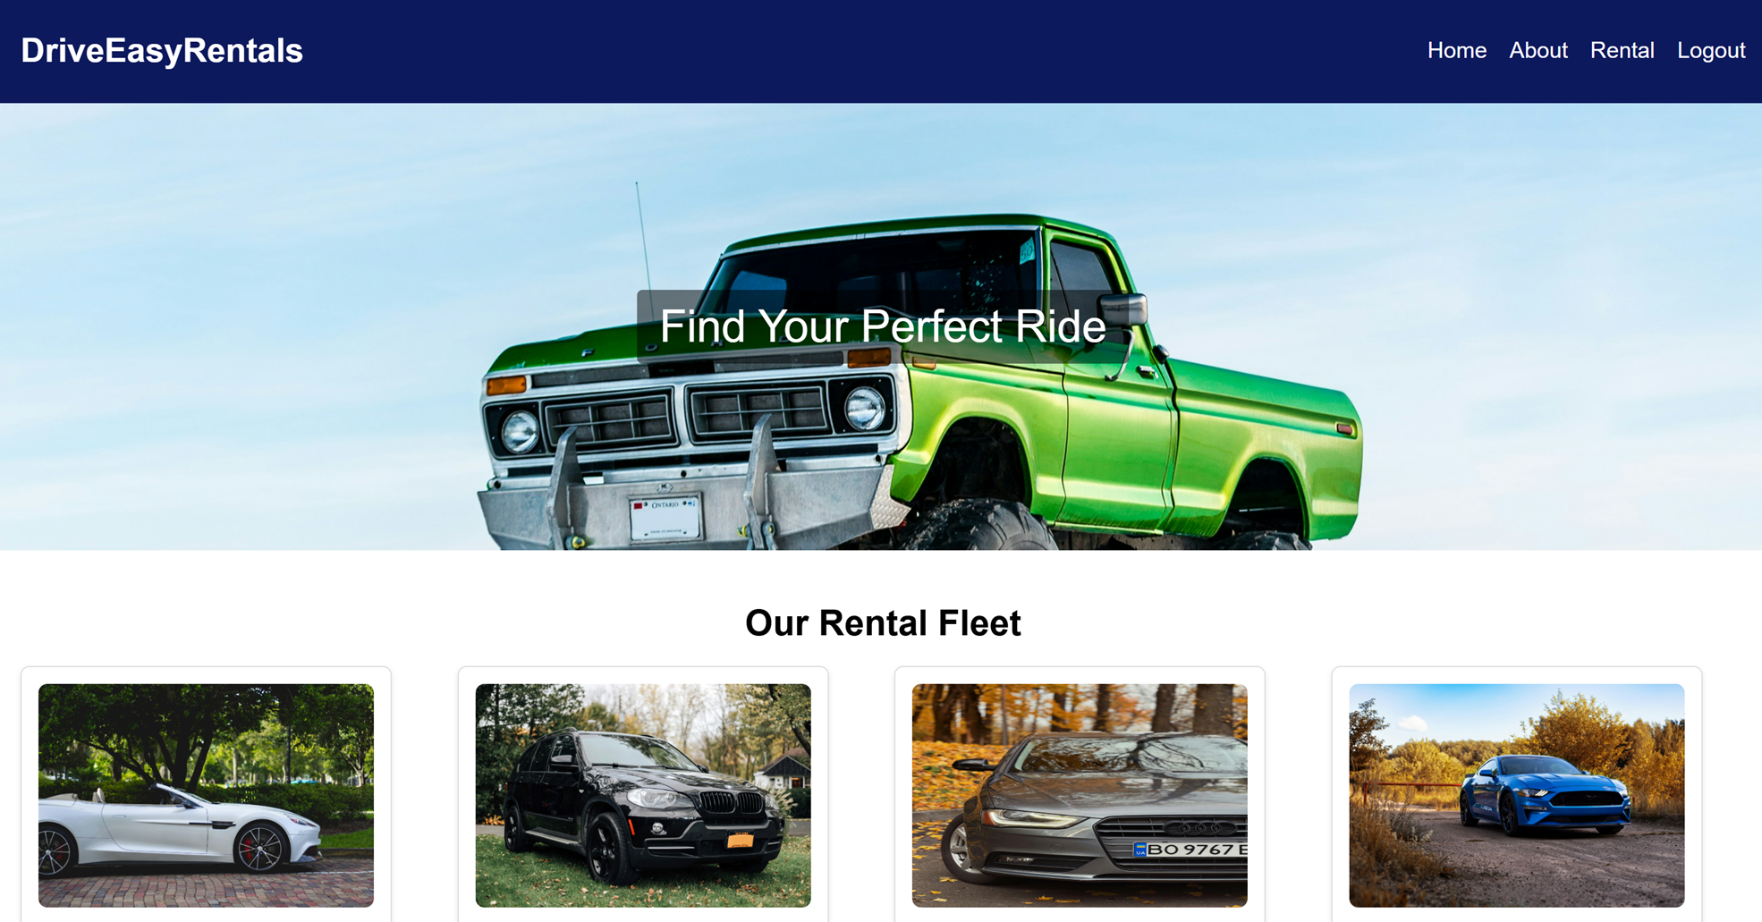
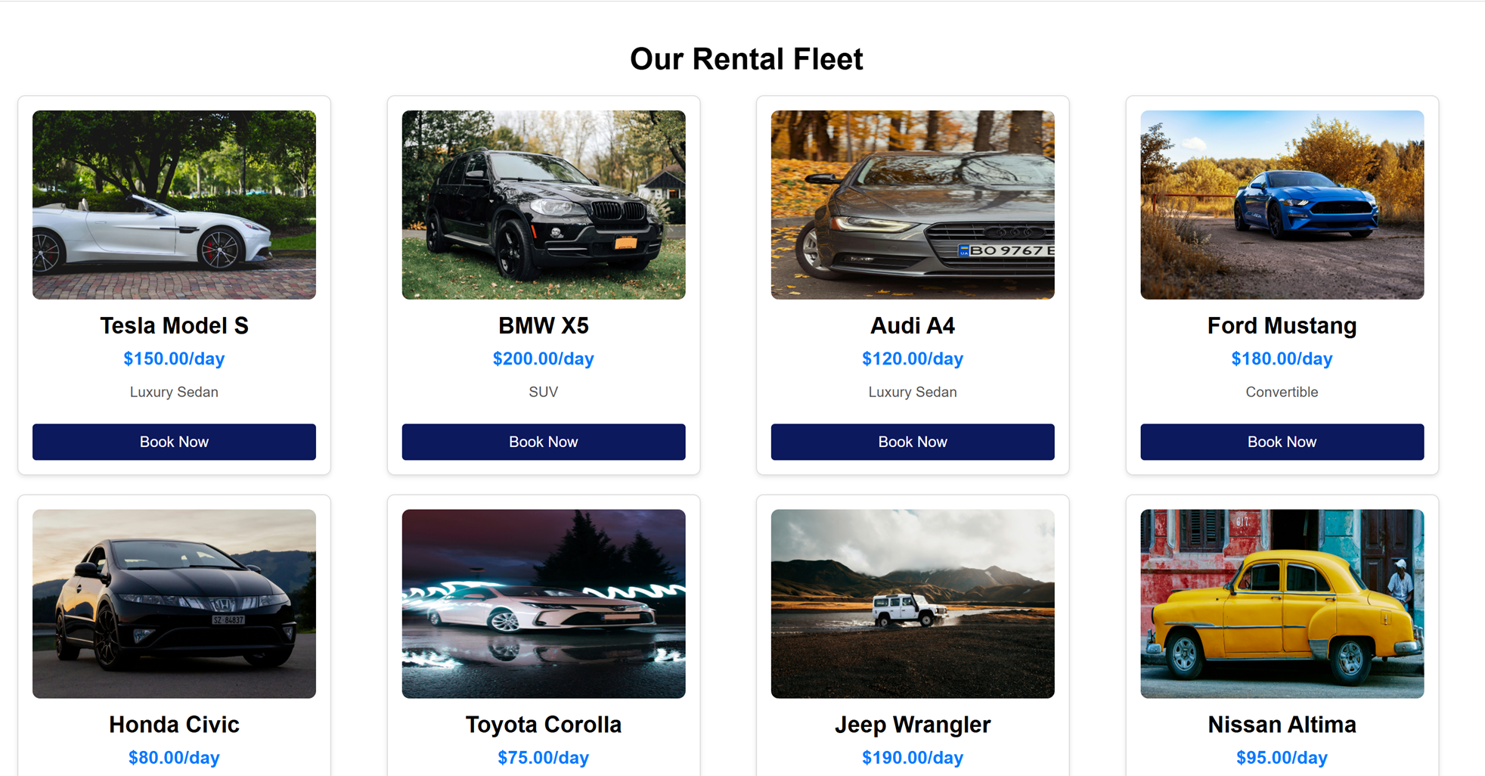
Rental page
This page shows the cars available on rent with their information.
The information like car name, price and model name shown dynamically which will get fetched from the database.
The book now button will redirect user to the booking page.

Slide 7
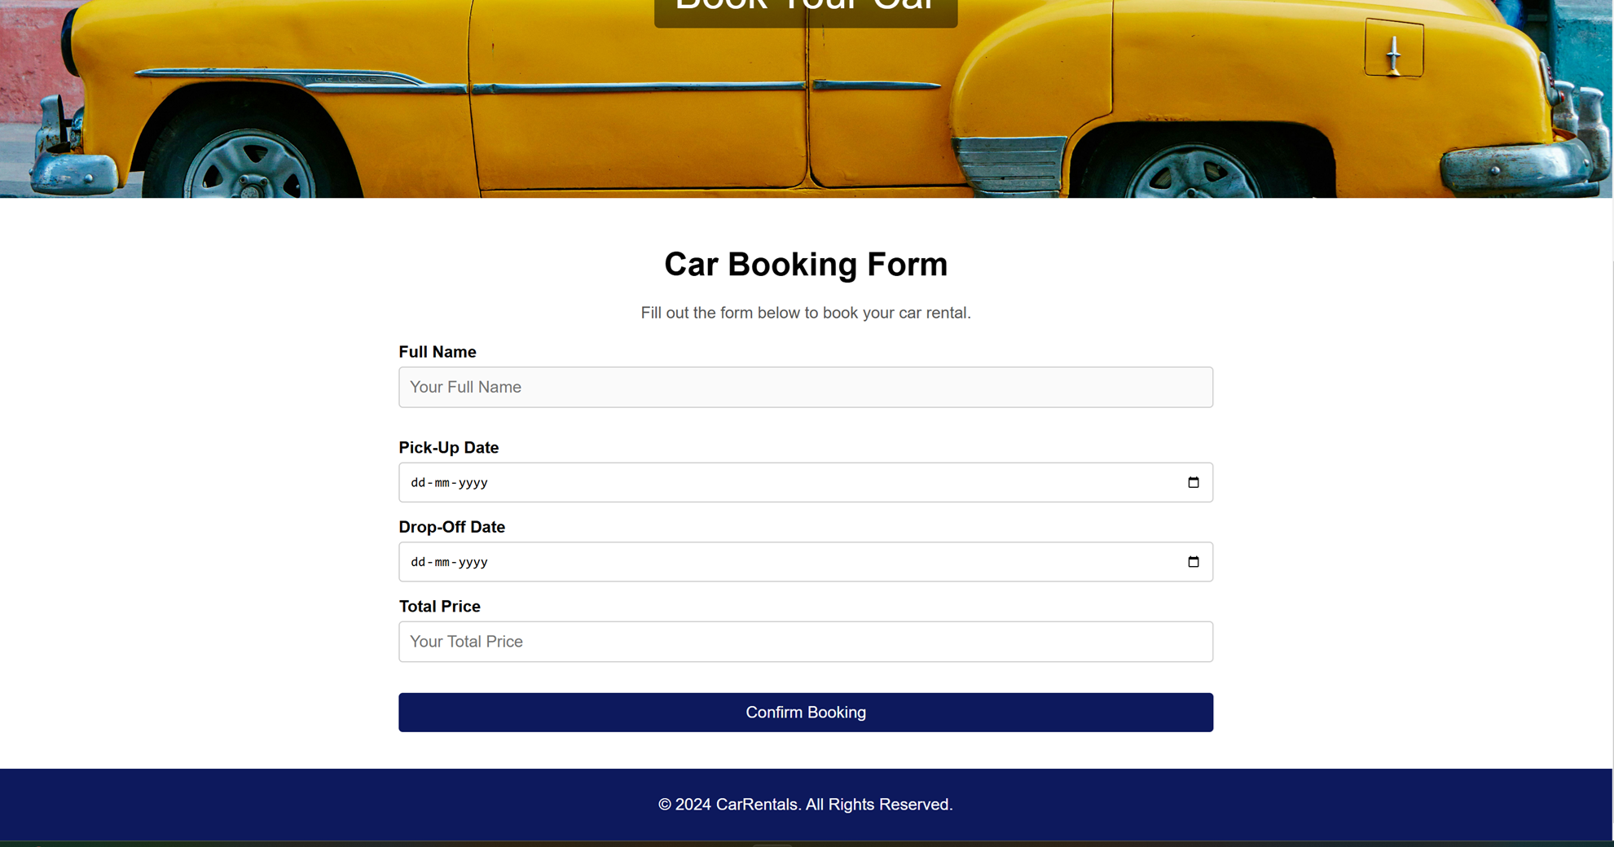
Booking page
This page shows the car rental booking page. The user requires to add all information in the form.
On clicking the confirm booking, the query is being called and the information will entered in the database.
The booking is considered to be confirmed if it is added properly.

Slide 8
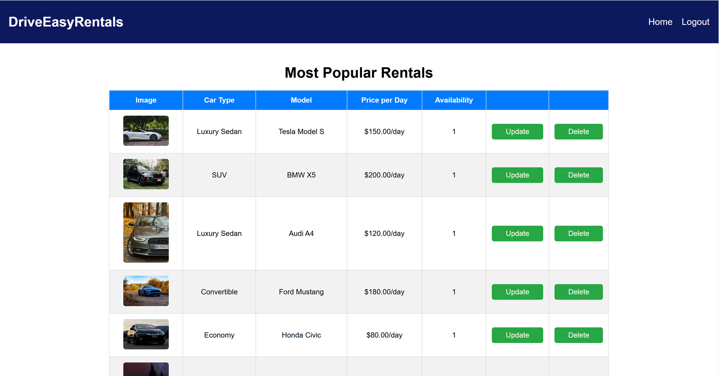
Admin index page
This is the main page of the admin side where all car details have been shown.
If admin wants to update then click on update and admin wants to delete then click on delete button.

Slide 9
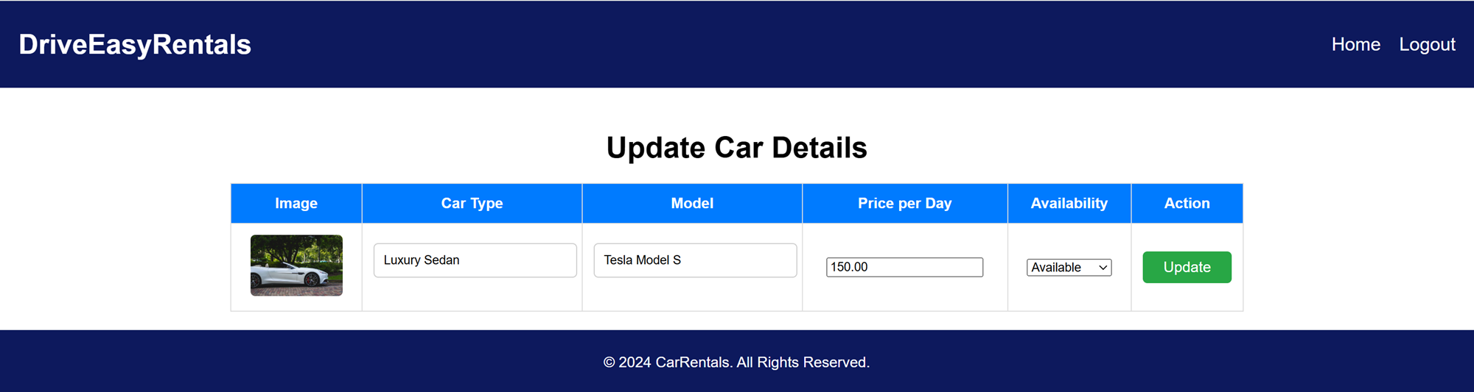
Update page
The information is shown in the table view where textbox is arranged in form of table.
All information is fetched through the database query.
Admin requires to change the already available information if required.
Then click on the update button which will update the data into the database.

Slide 10
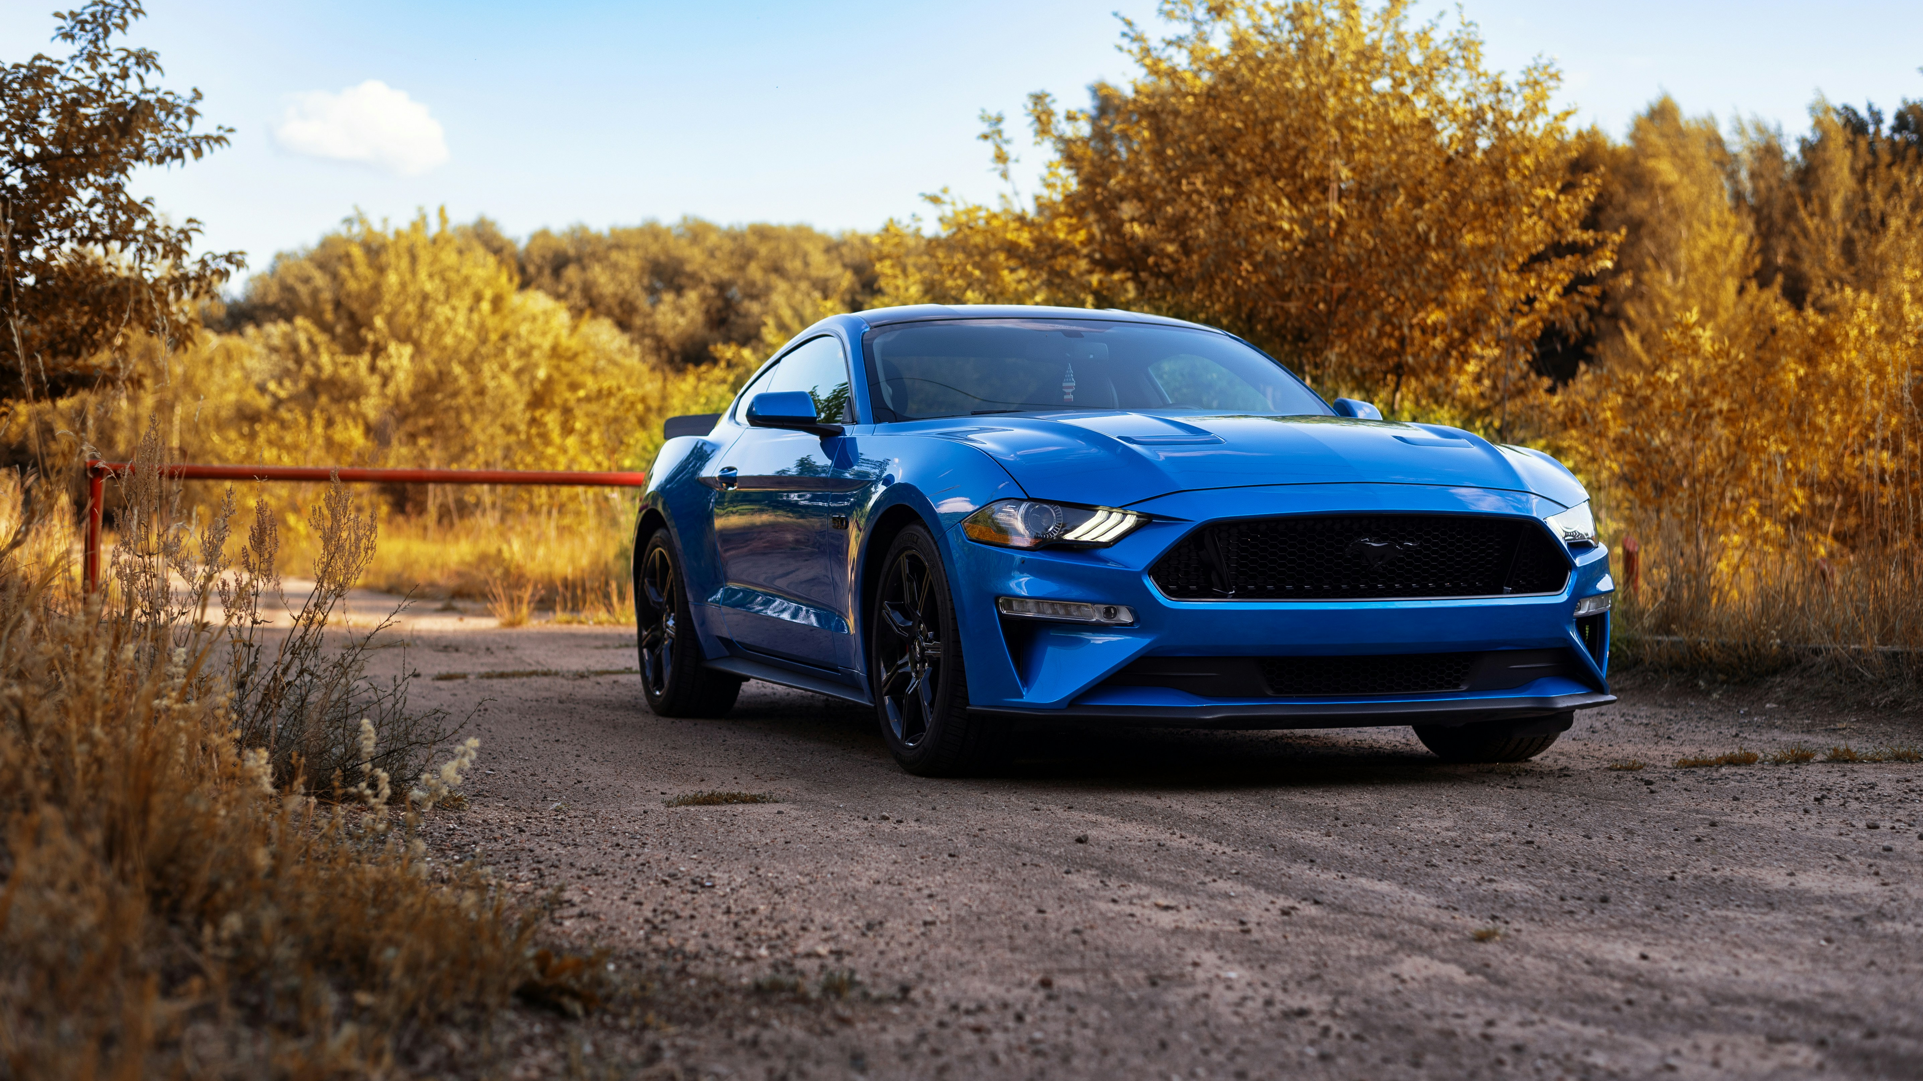
Drive Easy Rental Team

